Slide 1

Stock Recommendation Engine Using PySpark
Vinay Kumar Reddy Baradi
Sai Suraj Argula
Girija Bandaru
Anusha Seshagiri

Slide 2
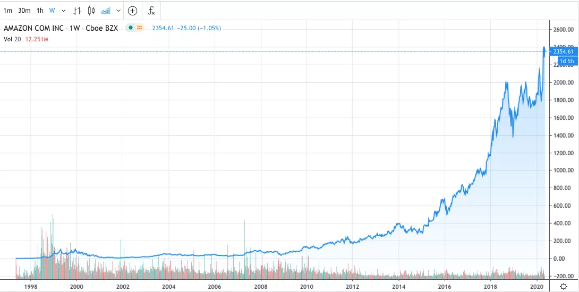
Why to invest in Stocks?
Stocks provide Highest potential of returns.
For example, Amazon
Compounding returns and Historically always Growing

Slide 3
Problem definition & Significance
To Build a Content based Stock recommendation engine for S&P 500 Companies using a scalable framework -PySpark.
To cluster S&P 500 Stocks based on information and Historical Data using Clustering techniques.

Slide 4
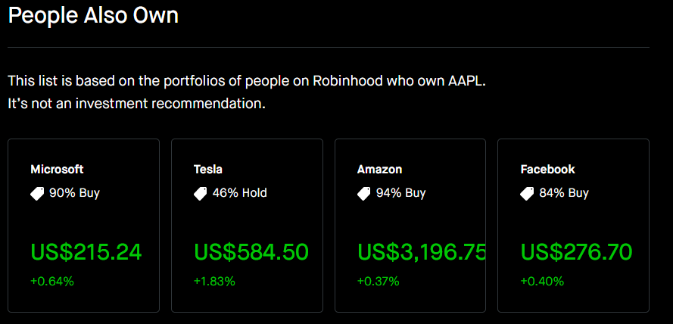
How Recommending Stocks will help investors?
Stock recommendation engine will help investors find similar stocks to invest as an alternative.
Based on similar company’s portfolio, growth, financials etc..

Slide 5
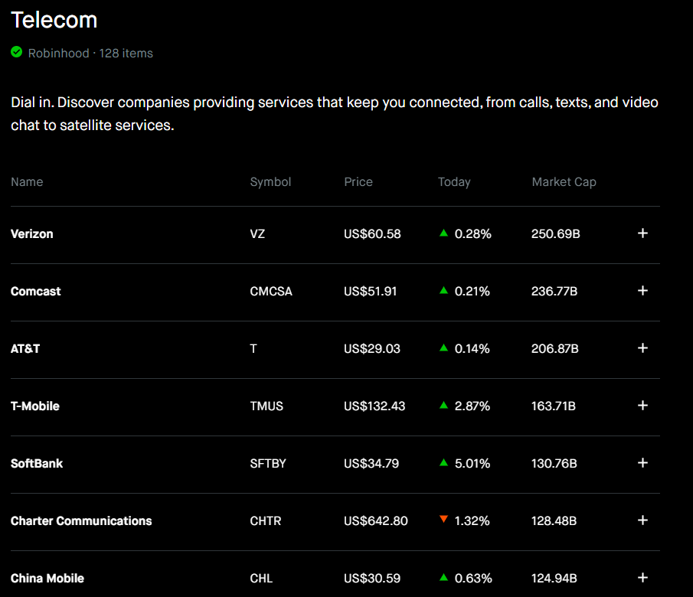
How clustering different companies will help an Investor?
Help find group of similar companies to analyze their characteristics and behaviors such as their profit ratios

Slide 6
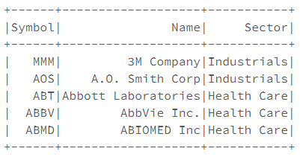
Data Collection
We collected data from Yahoo finance using Yfinance Python library.
Collected information of S&P-500 companies of their portfolios.

Slide 7
Variable Selection
Grouped data collected into following categories
Company details | Regular market details | >52week details | yearly details | Company growth details | Day share details
Sector | regularMarketOpen | averageVolume | earningsQuarterlyGrowth | dividendRate, | previousClose
longBusinessSummary | twoHundredDayAverage | averageDailyVolume10Day | fiveYearAverageReturn | marketCap, | forwardPE
fullTimeEmployees | regularMarketDayHigh | fiftyTwoWeekHigh | fiveYearAvgDividendYield | beta
Environment score(Sustainability) | regularMarketDayLow | fiftyTwoWeekLow | beta3Year | pegRatio,
Governance score | regularMarketPreviousClose | 52WeekChange | threeYearAverageReturn | lastDividentValue
Social score | regularMarketVolume | SandP52WeekChange |  | Volume
Industry | Currency | fiftyDayAverage
shortName |  | twoHundredDayAverage
 |  | payoutRatio

Slide 8
Data Preprocessing
Merged different data obtained from API calls using Ticker(Company Stock name)
Encoded Categorical Columns
Standardized Numerical Columns
Imputed numerical columns with Industry based sector Mean.
Imputed Categorical Columns with Industry based Sector Mode.
For Text Description, Split the data into words and removed stop words, created word2vec-300 representation of each company’s description.

Slide 9
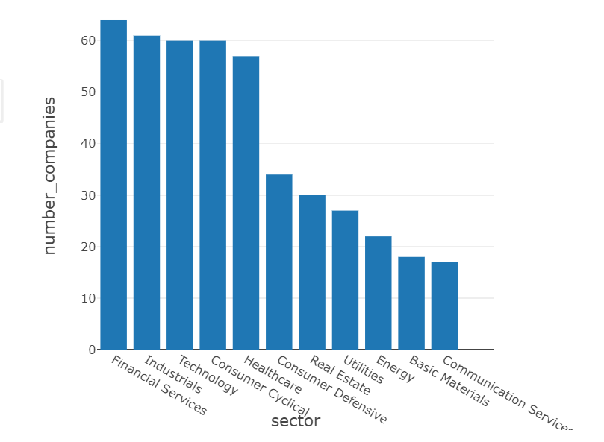
Exploratory Data Analysis
Number of Companies By Sector in S&P 500
Financial Service sector companies constitute the most in S&P 500, Communication services sector constitute the least

Slide 10

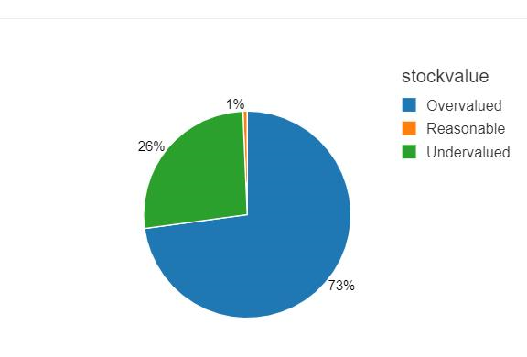
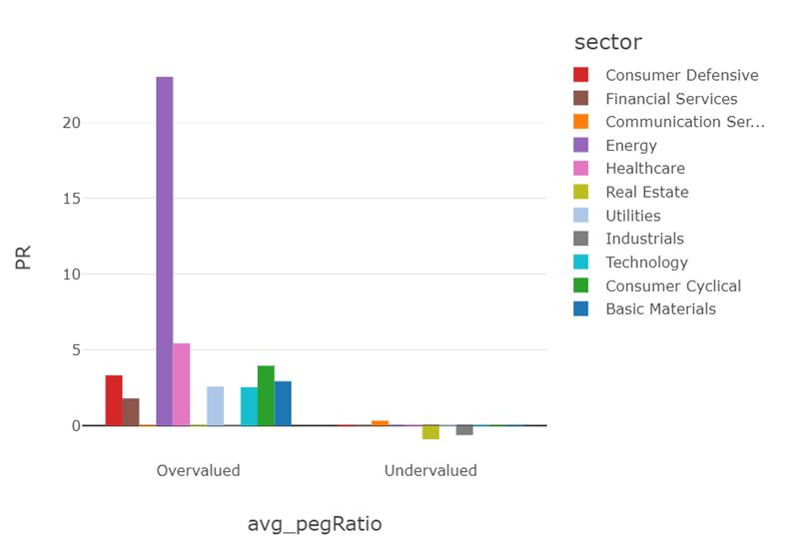
Exploratory Data Analysis
Undervalued(PegRatio<1) and Overvalued(PegRatio >1) Companies.
Undervalued(PegRatio<1) and Overvalued(PegRatio >1) sectors.

Slide 11
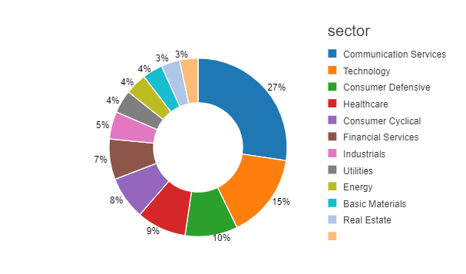
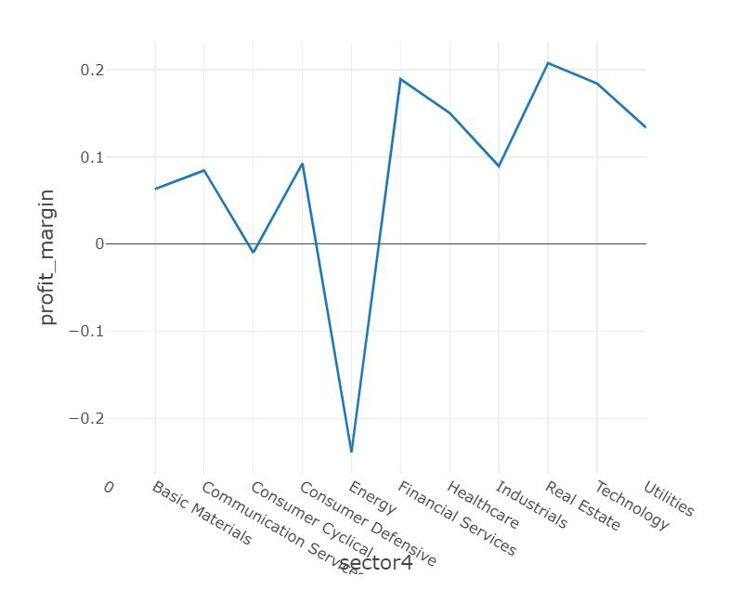
Exploratory Data Analysis
Average market capitalization by sector
Profit Margin
It represents what percentage of sales has turned into profits.

Slide 12
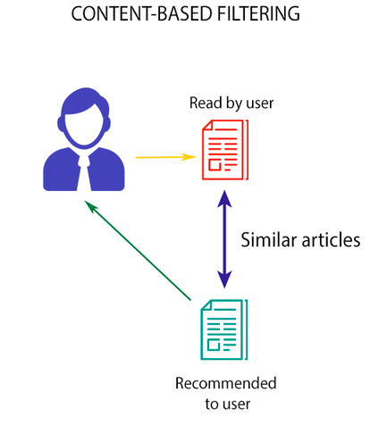
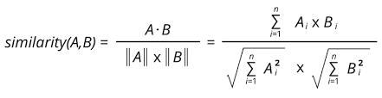
Model Building
Content Based Recommendation Engine
Cosine Similarity(K-Nearest Neighbours)
Based on Text–Description
Based on Company Variables

Slide 13
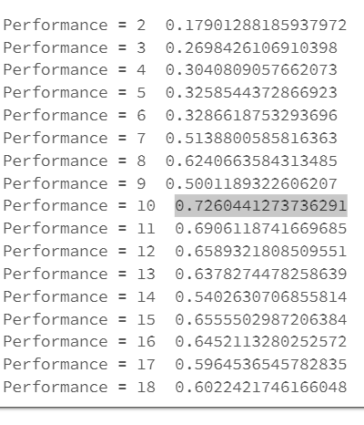
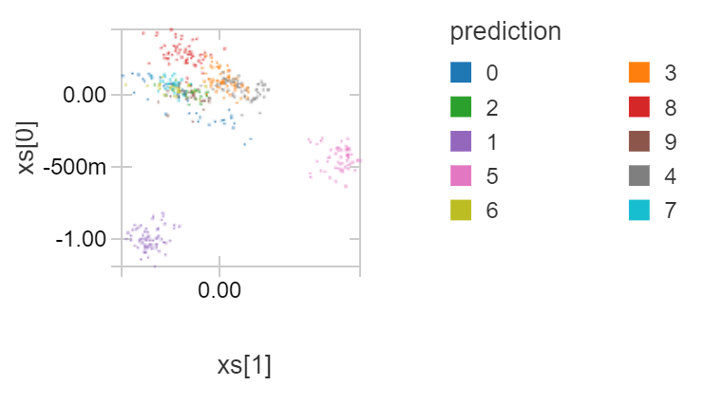
Model Building
K-means Clustering of Companies
Silhouette technique to measure K
K=10 Silhouette coefficient greater
Applied PCA of the features to visualize clusters in 2Dimensions

Slide 14
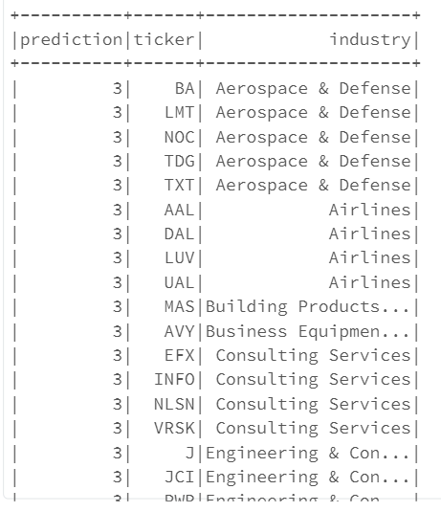
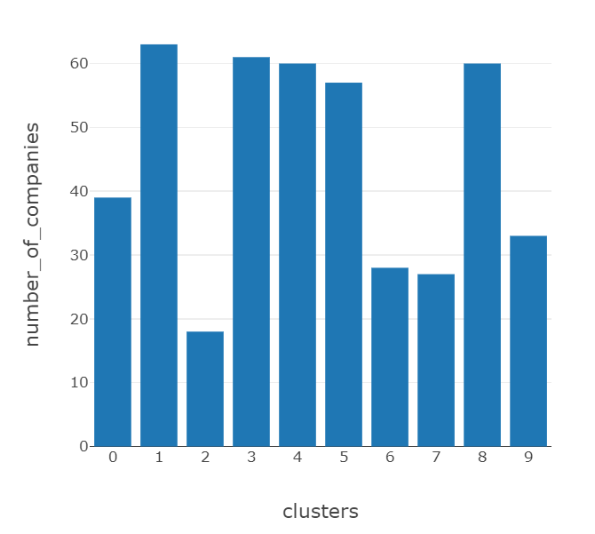
Insights for Investors
Example Cluster
Cluster distribution

Slide 15
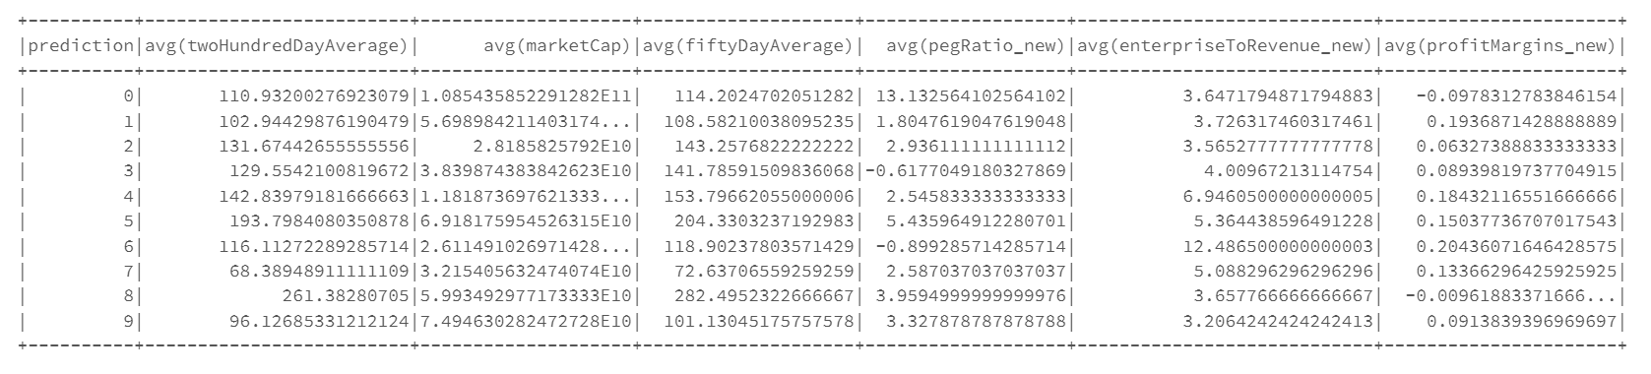
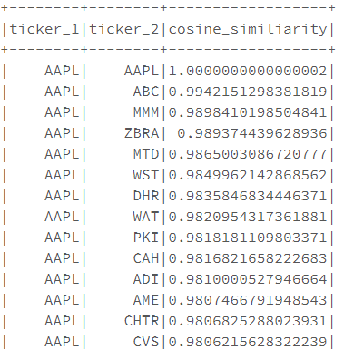
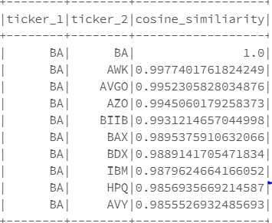
Insights for Investors
Cluster summary
Recommendations
Text Description
Company Details

Slide 16
Future Work
Scale work for all the NYSE registered companies
Include Historical Stock price data of stocks
Improve Data Preprocessing and Imputation methods
Include more related variables for model building
Including News abut companies on a particular day to improve recommendations
Include User data if available open source for building user based collaborative recommendation engine on top of recommendation engine we built.
Grouping companies based on projected growth and recommend

Slide 17
References
https://in.finance.yahoo.com/
https://www.investopedia.com/
https://toughnickel.com/personal-finance/10-Factors-to-Consider-When-Selecting-a-Stock
https://pypi.org/project/yfinance/
https://towardsdatascience.com/parse-thousands-of-stock-recommendations-in-minutes-with-python-6e3e562f156d

